Slide 1
Spanning Tree

Slide 2
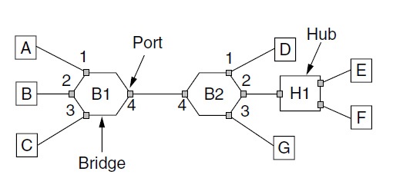
Learning Bridges
Bridges (and a hub) connecting seven point-to-point stations.

Slide 3
Spanning Tree
What if a bridge topology has loops?

Slide 4
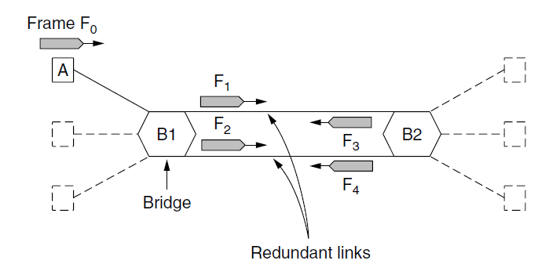
Spanning Tree Bridges (1)
Bridges with two parallel links

Slide 5
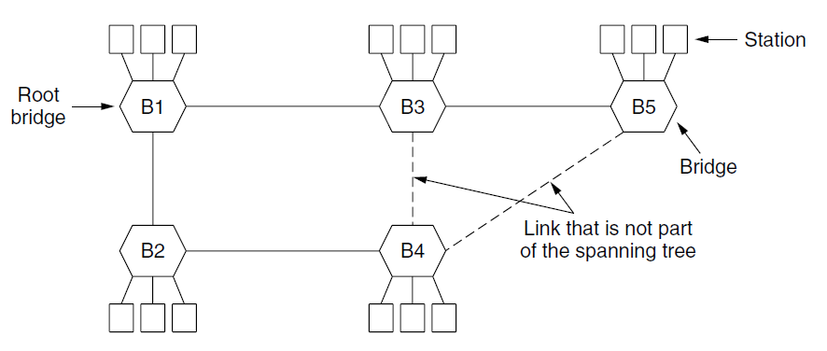
Spanning Tree Bridges
A spanning tree connecting five bridges. The dotted lines are links that are not part of the spanning tree.

